Slide 1

EDUCATE | INSPIRE | REPRESENT

Slide 2
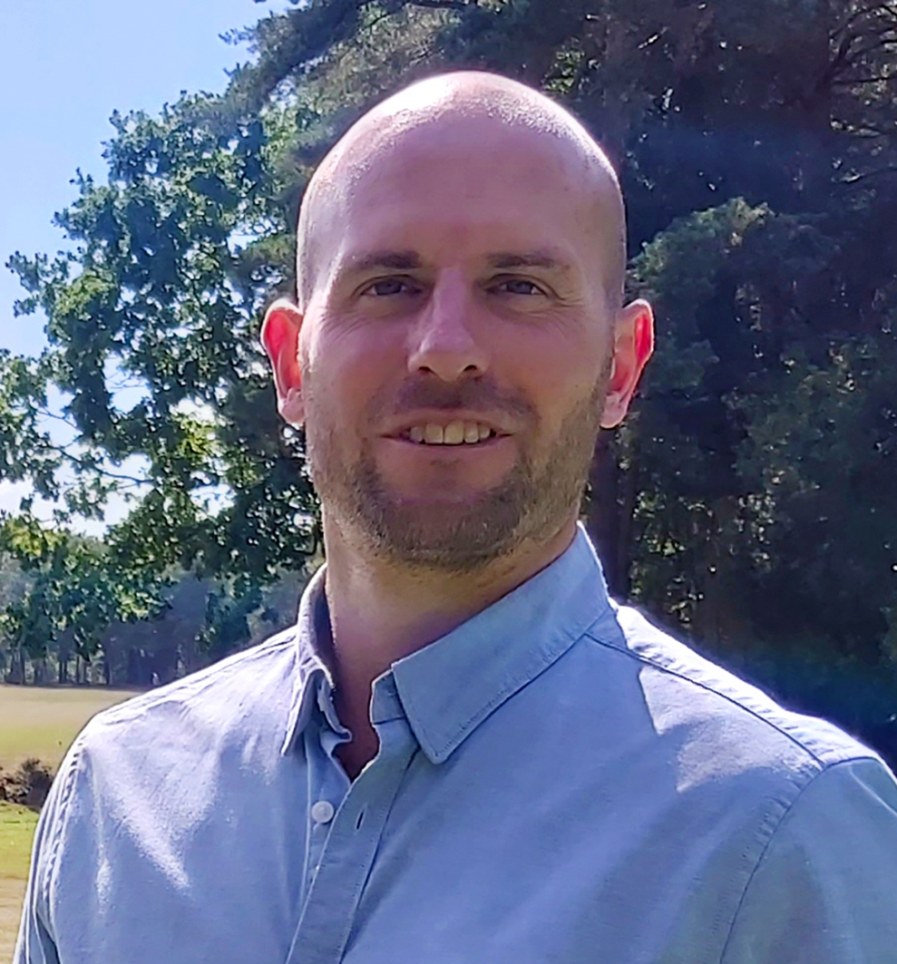


WHO
WE ARE
The Golf Club Managers Association was originally formed in 1933: by Golf Club Managers, for Golf Club Managers.
We have a history and heritage to be proud of, but alongside this we have an exciting vision for developing and shaping the future of Golf Club Management in the UK and believe that our Members are at the very heart of everything that we do.
As the leading association for Golf Club Management in the UK, we are committed to making a positive difference to the game of golf, through supporting the professional and personal wellbeing of our Members.
We recognise the importance of not only providing our members with technical guidance and advice, but also delivering a wide range of education and professional development opportunities AND supporting personal development and wellbeing.
We’d love to welcome you as a Member of our association and we look forward to supporting and working alongside you.
Tom Brooke
CEO - GCMA
EDUCATE | INSPIRE | REPRESENT

Slide 3


OUR
VALUES
INSPIRE
We engender a sense of community with a culture of modern and progressive leadership.
EDUCATE
We provide quality and relevant professional services and qualifications for our Members.
INSPIRE
We engender a sense of community with a culture of modern and progressive leadership.
EDUCATE
We provide quality and relevant professional services and qualifications for our Members.
REPRESENT
We ensure Members’ voices are heard and we influence the direction of golf in the UK.
REPRESENT
We ensure Members’ voices are heard and we influence the direction of golf in the UK.
EDUCATE | INSPIRE | REPRESENT

Slide 4
YOUR
MEMBERSHIP
Welcome to your GCMA membership, which unlocks a community of like-minded professionals, supports you in your professional and personal development and provides you with a multitude of benefits – from tools and services to allow you to excel in your profession, to a wide range of retail discounts for you and your family.
Your benefits. Your development. Your community.
EDUCATE | INSPIRE | REPRESENT

Slide 5
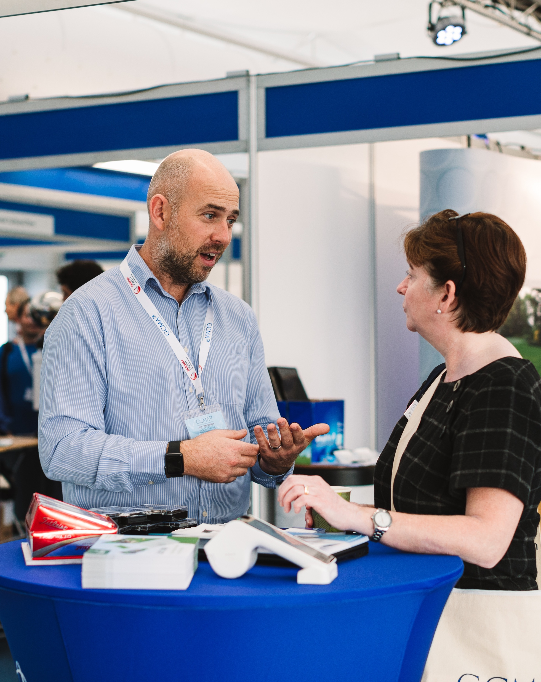






YOUR
BENEFITS
PERKS AT WORK
Discounts and special offers from thousands of retail and service providers through our dedicated online platform.
ONLINE INFORMATION LIBRARY
Advice, templates and information documents covering all areas of golf club management.
GOLF MANAGEMENT HELPDESK
Our online helpdesk is staffed by industry experts to swiftly answer your management questions.
EMPLOYMENT LAW HELPLINE
Support in the workplace for members on a personal level.
GCMA COMMUNITY ONLINE ACADEMY
Hundreds of free online webinars and workshops to support your personal wellbeing. Take part in fitness classes and yoga lessons; and benefit from presentations on leadership skills and wellbeing workshops.
GCMA BUSINESS PARTNERS
Up to date and high-quality advice and support on all technical and operational golf club management issues from our valued partners – providing Members with exclusive offers and discounts to benefit both you and your golf club.
Support
A members’ benevolent fund.
EDUCATE | INSPIRE | REPRESENT

Slide 6



YOUR
DEVELOPMENT
QUALIFICATIONS
Access the nationally accredited Diploma in Golf Club Management and BA Hons in Golf Club Management degree – the only industry-specific qualifications of their kind.
PROFESSIONAL DEVELOPMENT
Progressive, industry-specific education programmes, including residential and online education and development services.
GCMA SKILLGATE INFINITY
Our dedicated online learning and CPD platform including over 1,300 courses covering key topics of business management, finance, leadership and wellbeing.
PERSONAL DEVELOPMENT AND WELLBEING
Access the GCMA INSPIRE series and our online wellbeing and personal development toolkits and learning modules.
WEBINARS
Access our comprehensive webinar series, which includes: GCMA Hot Topics, GCMA Know How & GCMA Inspire.
EDUCATE | INSPIRE | REPRESENT

Slide 7
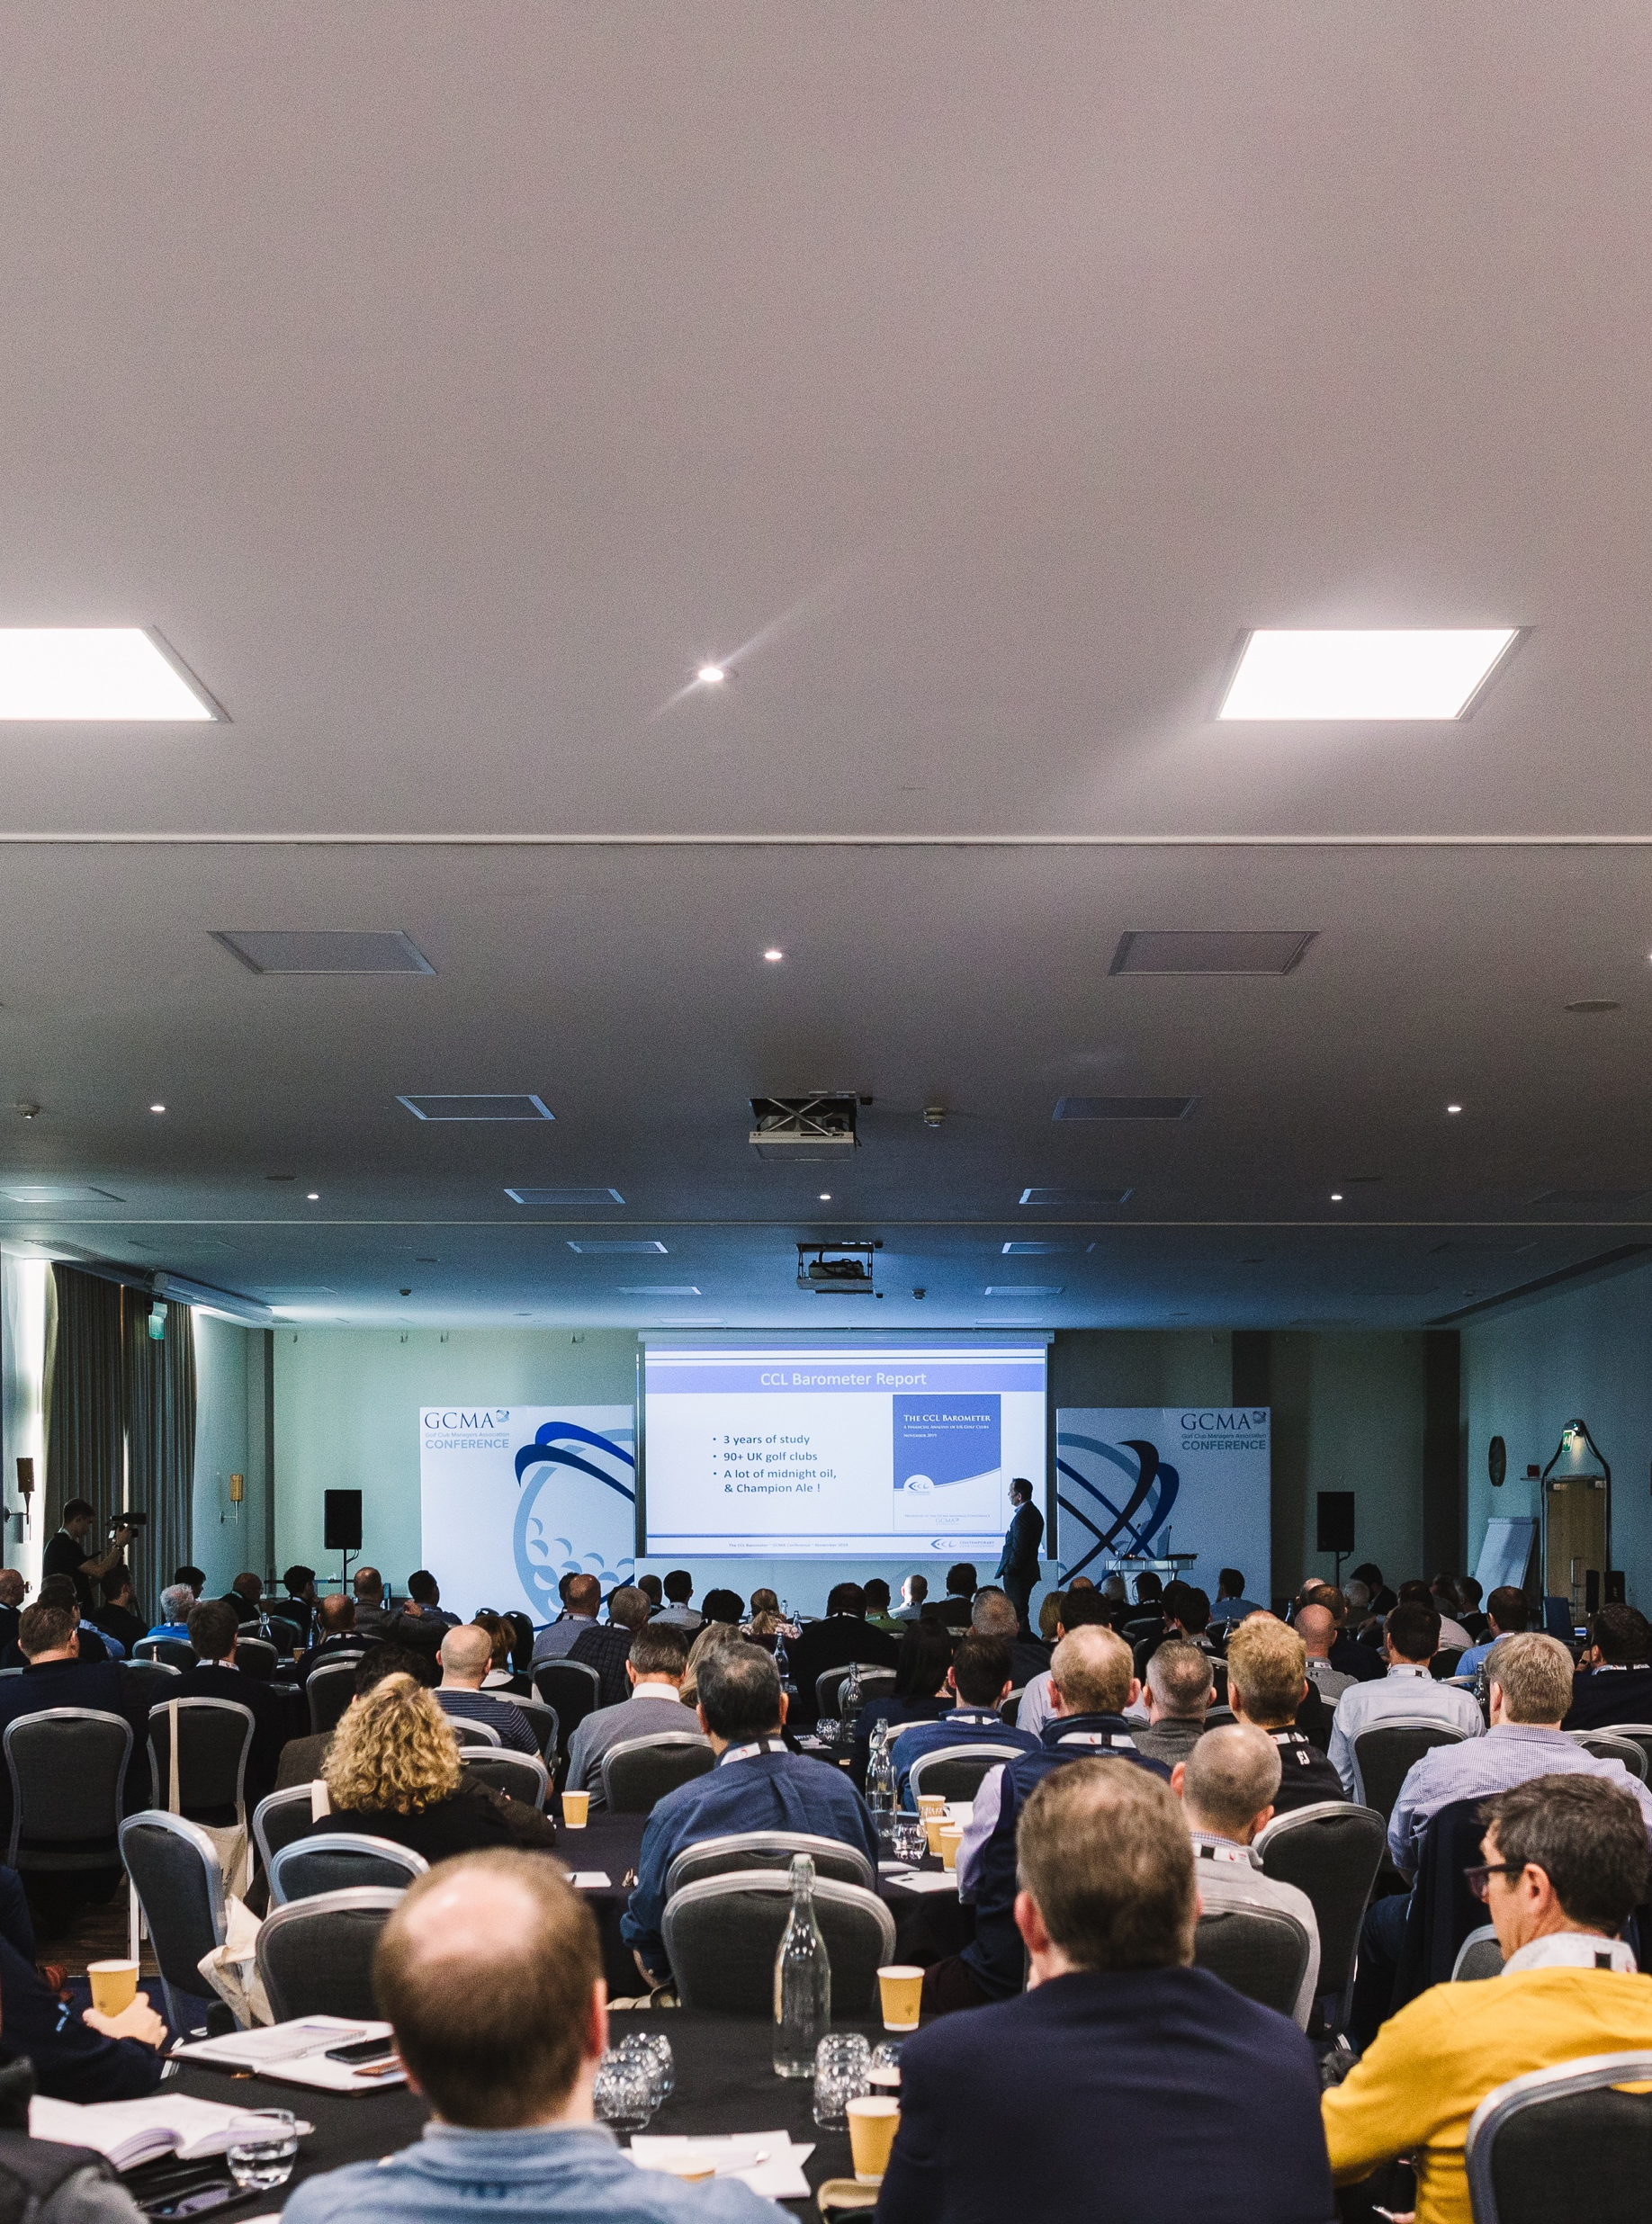





YOUR
COMMUNITY
NETWORKING
Invaluable regional and national networking opportunities with other industry professionals, organisations and, most importantly, your fellow Members.
E-MAGAZINE
Subscription to our respected monthly journal: The Golf Club Manager.
WEEKLY E-NEWSLETTER
Keeping you up to date with all the latest news and advice from within the industry.
THE GCMA ANNUAL CONFERENCE
Invitation to attend the annual GCMA conference.
FUTURE LEADERS
Led by some of our most successful and well respected members, supporting the next generation of golf club managers and shaping the future of the industry.
CLUB MANAGEMENT AWARDS
Recognising outstanding performances among GCMA Members.
EXCLUSIVE GOLF COMPETITIONS AND EVENTS
The opportunity to represent the association in regional and international matches..
Support
A members’ benevolent fund.
EDUCATE | INSPIRE | REPRESENT

Slide 8

PROFESSIONAL DEVELOPMENT
We aim to help and support you to manage your own learning and growth throughout your career. Our Professional Development and Education products and services are designed to be varied in content and flexible in delivery to suit everyone’s needs, regardless of career profile and experience.
EDUCATE | INSPIRE | REPRESENT

Slide 9
PROFESSIONAL DEVELOPMENT & EDUCATION
GCMA ESSENTIAL LEADERSHIP SKILLS
Suitable for all and open to both Members and non-members. This webinar series is perfect for anyone interested in a career in golf club management, or somebody already in a junior or middle management role in a golf club.
For more information - click here.
PRINCIPLES OF GOLF CLUB MANAGEMENT
Suitable for those aspiring to become a Golf Club Manager, those new to the profession and those looking to brush up on some of their skills.
This one-week course provides you with a fantastic overview of all of the key proficiencies that you need to become a knowledgeable and well-informed industry professional.
For more information - click here.
EDUCATE | INSPIRE | REPRESENT

Slide 10

PROFESSIONAL DEVELOPMENT & EDUCATION
ASQ L5 DIPLOMA IN GOLF CLUB MANAGEMENT
Suitable for, and open to, all levels of skills and experience, this accredited golf-specific qualification is perfectly suited both for existing managers and those looking to move into the profession.
The Diploma covers all the core skills required to manage a golf club, and notably is an ASQ externally quality-assured qualification, visible on the framework of regulated qualifications.
For more information – click here.
BA (HONS) GOLF CLUB MANAGEMENT
The Golf Club Management degree is a unique programme that has been designed to meet the needs of the contemporary golf club business. It is delivered by Cornwall College in partnership with the GCMA and Colt Mackenzie McNair.
It is suitable for aspiring managers looking to start their golf club management journey as well as existing managers looking to take their next career step and builds on the L5 Diploma in Golf Club Management.
For more information – click here.
EDUCATE | INSPIRE | REPRESENT

Slide 11


PROFESSIONAL DEVELOPMENT & EDUCATION
GCMA SKILLGATE INFINITY
SkillGate is an integral part of our commitment to your professional and personal development. SkillGate is an online learning platform where Members gain FREE access, via the GCMA website or the SkillGate app, to over 1,000 courses – ranging from 30-minute tutorials to full certificates.
Topics and learning opportunities include:
Achieve Your Potential
Better Communication
Develop Your Talents
Finance
IT Skills
Managing Business
Managing People
Remote Working
Sales and Service
Wellbeing
Written English
EDUCATE | INSPIRE | REPRESENT

Slide 12



GCMA
WEBINAR SERIES
Regular webinars and presentations, covering a wide range of topics including principles of leadership, emotional intelligence and team building.
A library of technical and business skills webinars and interviews with our Business Partners and education collaborators. covering the key aspects of day to day Golf Club Management.
Live webinars, online discussions and Q&As tackling the major issues of the day within the golf industry. We put the most accurate and up-to-date information in front of our Members, delivered by Industry leaders.
EDUCATE | INSPIRE | REPRESENT

Slide 13











GCMA BUSINESS
PARTNERSHIPS
EDUCATE | INSPIRE | REPRESENT

Slide 14











GCMA BUSINESS
PARTNERSHIPS
EDUCATE | INSPIRE | REPRESENT

Slide 15
JOIN
THE GCMA
MEMBERSHIP CATEGORIES
FULL MEMBERSHIP: £320 per year
AFFILIATE MEMBERSHIP: £200 per year
RETIRED MEMBERSHIP: £90 per year
Click here to join.
GCMA REGIONAL MEMBERSHIP
Our Regional Networks provide fantastic networking opportunities and regular communication and act as an excellent source of information and support. Build friendships and benefit from getting to know your fellow GCMA Members.
Click here for more details and to find out more about your local region.
EDUCATE | INSPIRE | REPRESENT

Slide 16



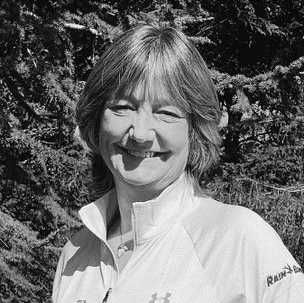


THE GCMA
TEAM
TOM BROOKE
CEO
tom@gcma.org.uk
GAVIN ROBINSON
PROFESSIONAL DEVELOPMENT MANAGER
gavin@gcma.org.uk
CRAIG COTTERILL
PARTNERSHIPS MANAGER
craig@gcma.org.uk
NATALIE MCCOLL
MEMBERSHIP SERVICES MANAGER
natalie@gcma.org.uk
KERRY SPRING RICE
MEMBERSHIP SERVICES
memberservices@gcma.org.uk
LIANNE WHEELER
FINANCE OFFICE
lianne@gcma.org.uk
TIM BAKER
MEMBERSHIP SERVICES
tim@gcma.org.uk
CONTACT US www.gcma.org.uk 01275 391 153
EDUCATE | INSPIRE | REPRESENT

Slide 17
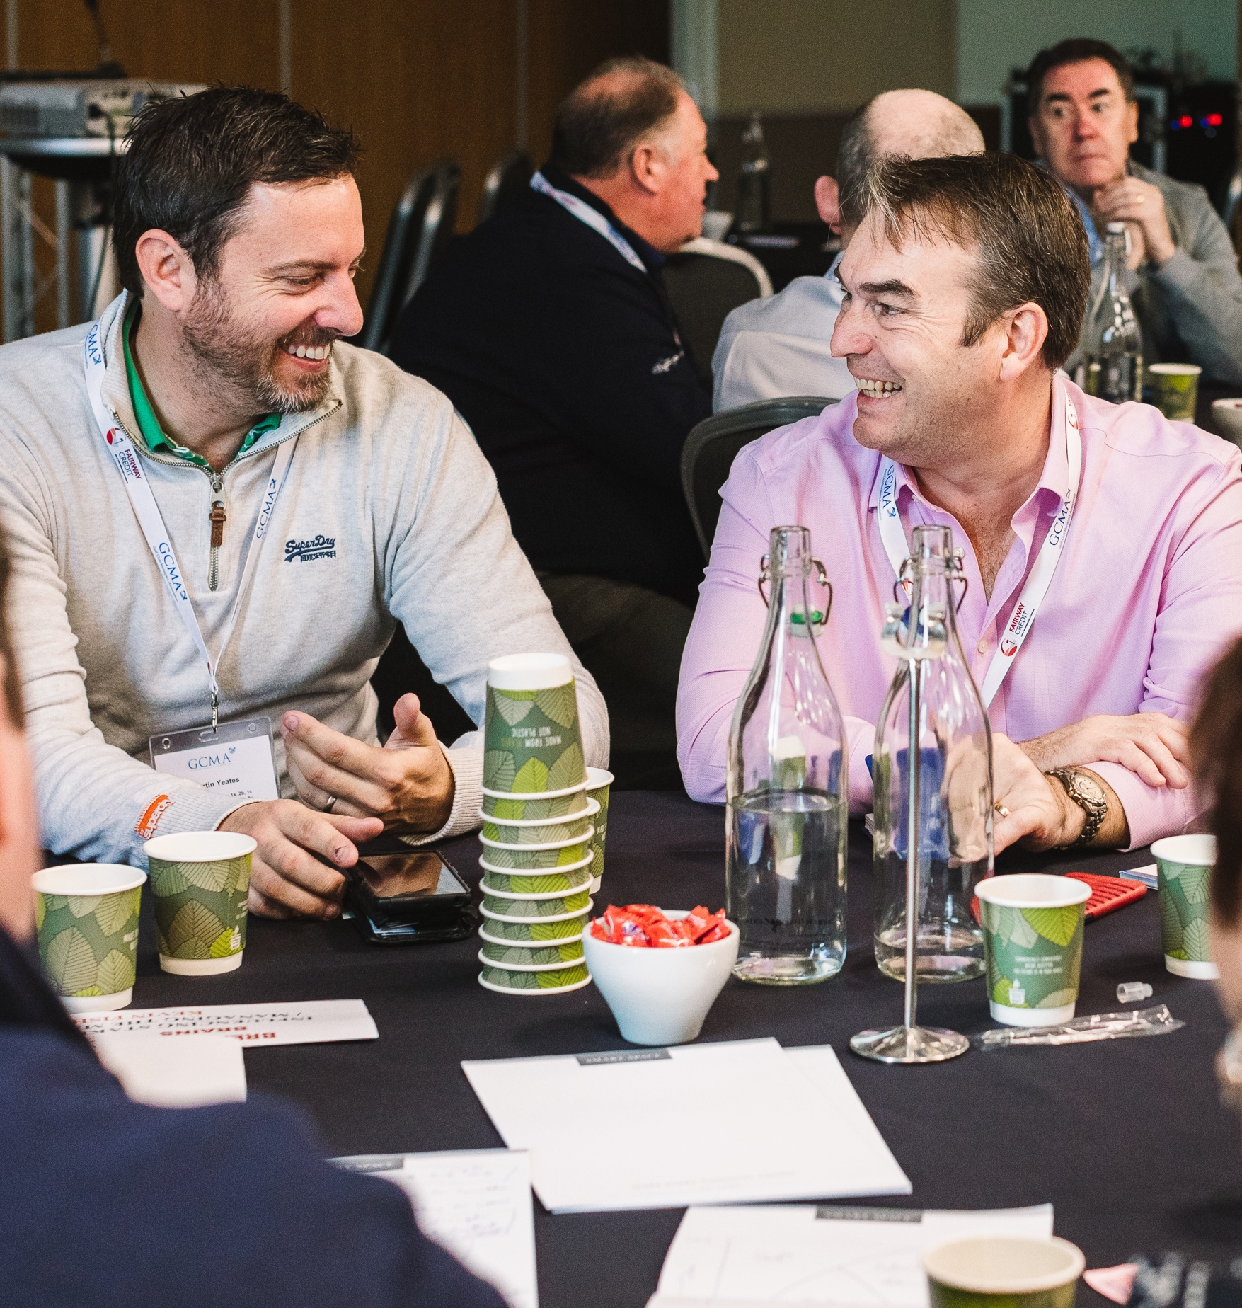
WELCOME TO
OUR COMMUNITY

